Slide 1
Miks AI prototüübid tunduvad geneerilised?

Slide 2
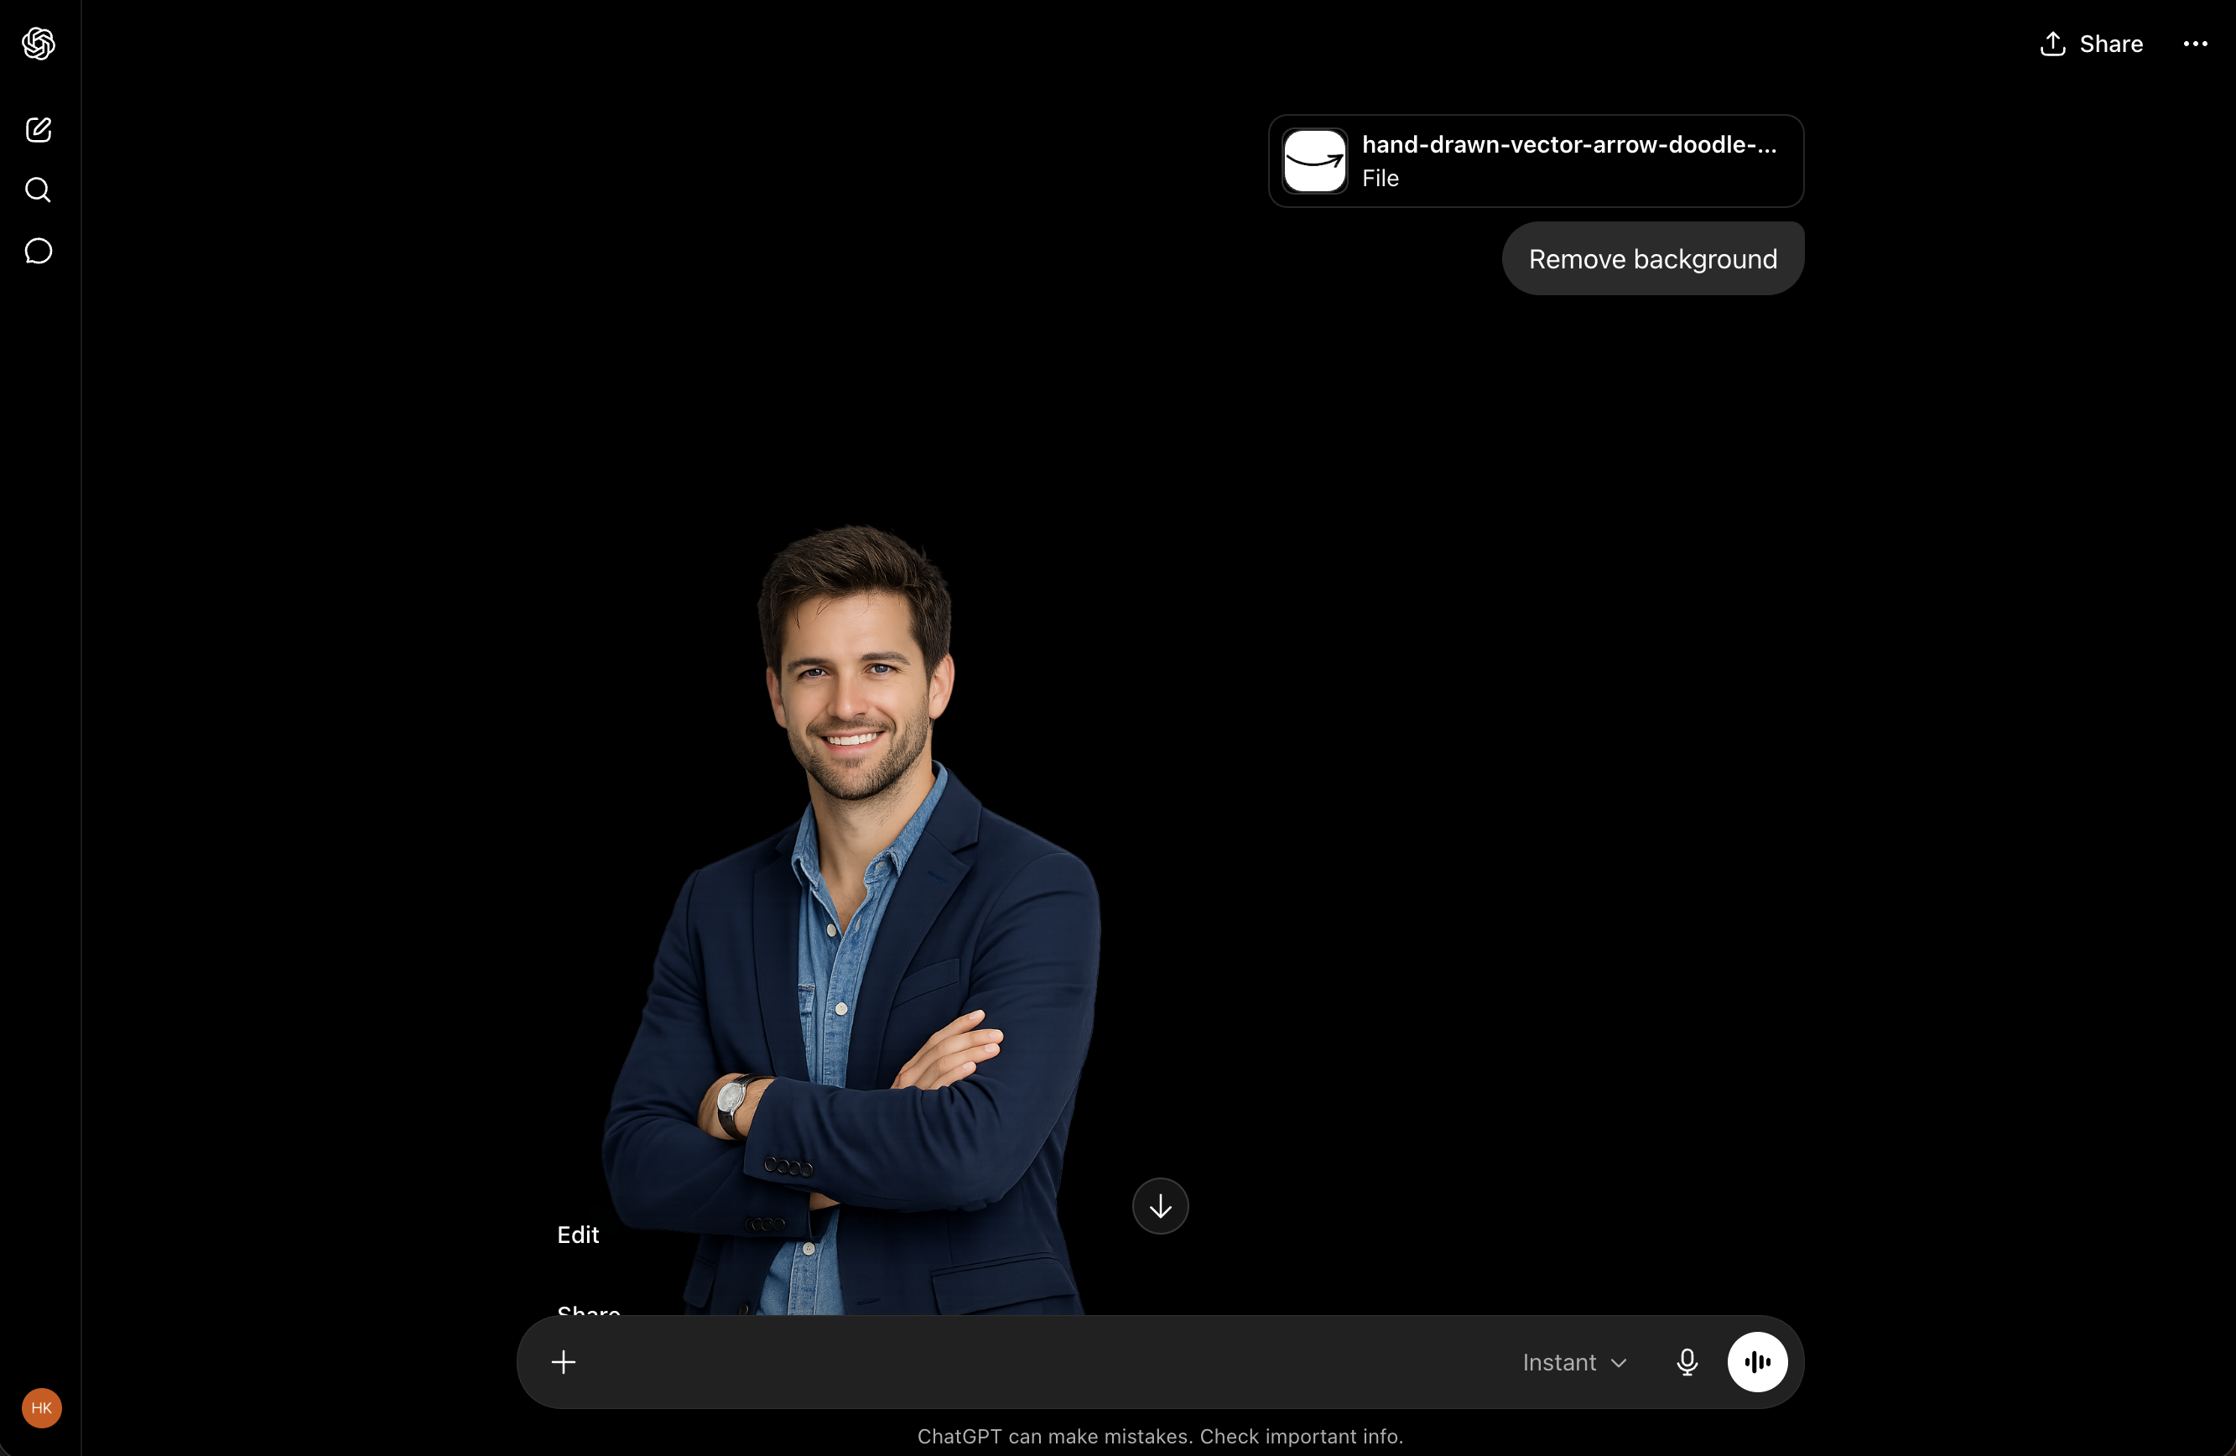

Slide 3
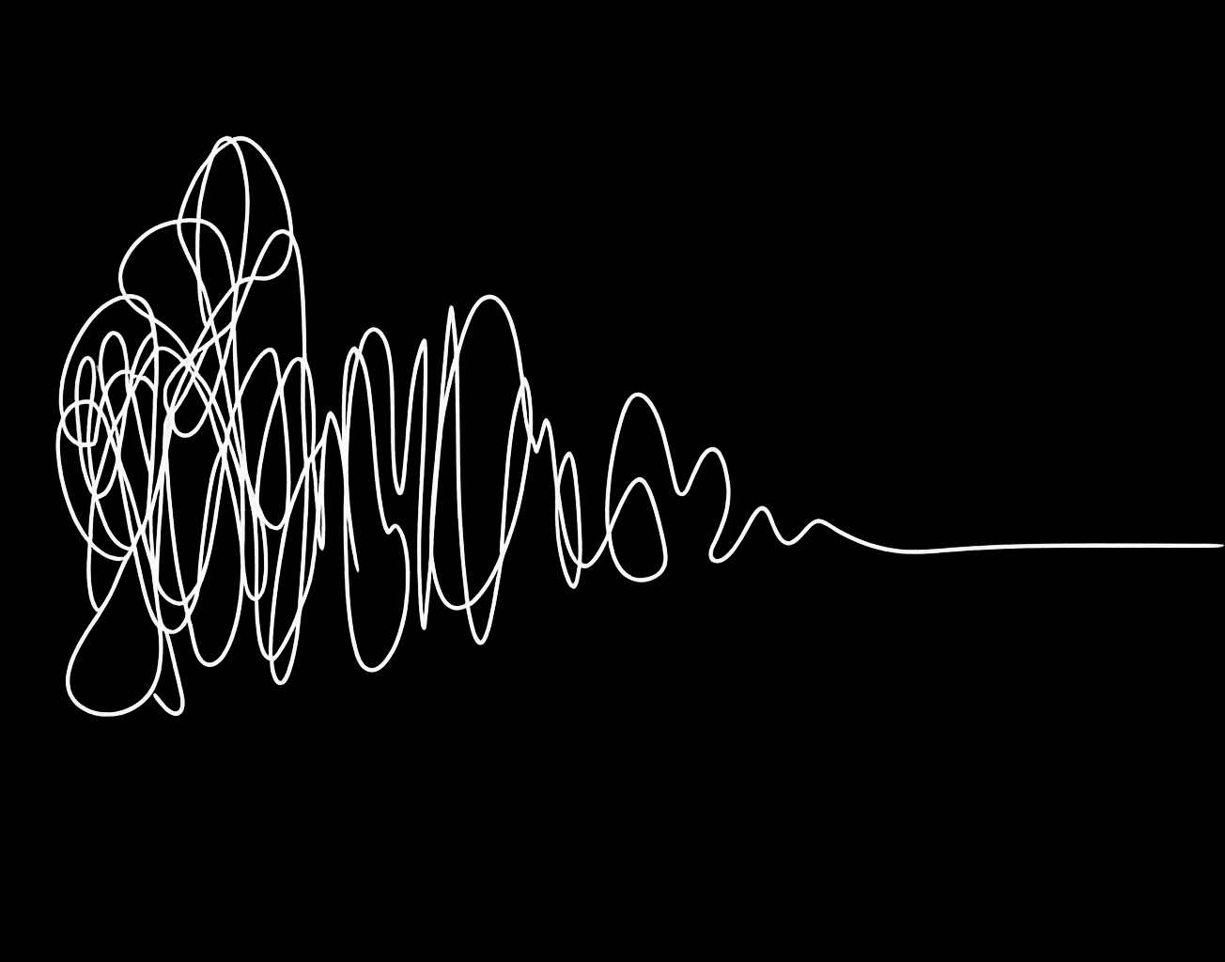

Slide 4
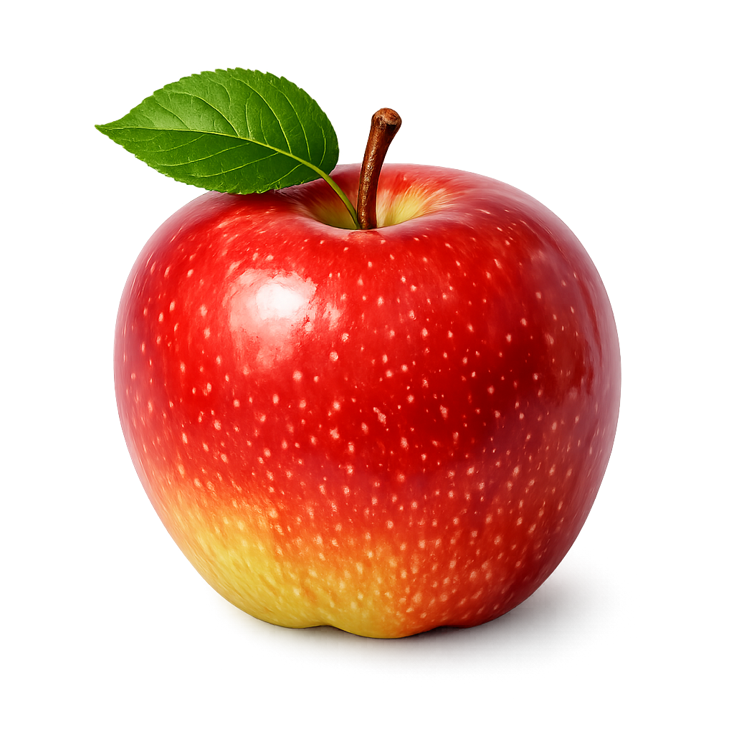

Slide 5
PROMPT 1
Create a productivity app for freelancers

Slide 6
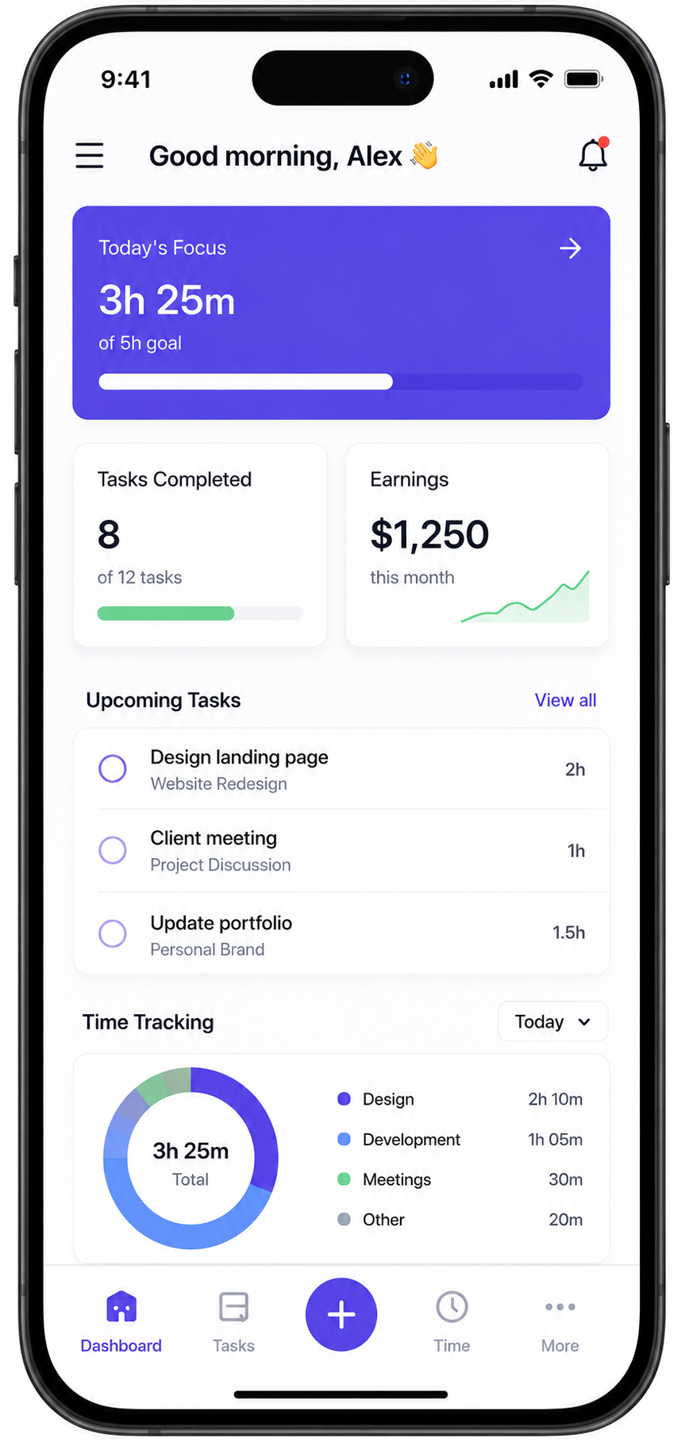
Notes:
Result:
• dashboard,
• task list,
• gradient UI,
• generic AI assistant.

Slide 7
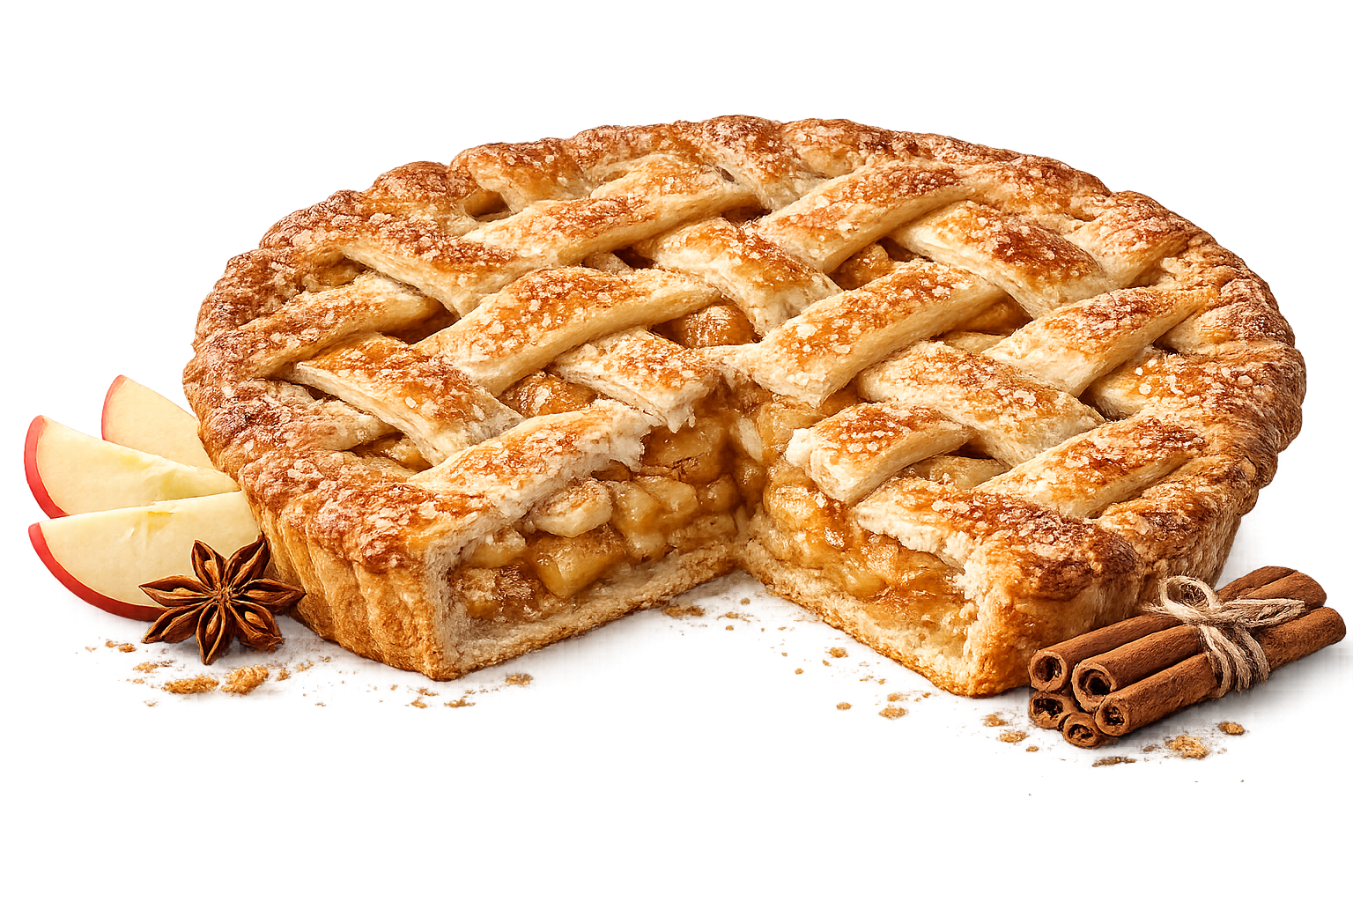
Notes:
Result:
• dashboard,
• task list,
• gradient UI,
• generic AI assistant.

Slide 8
PROMPT 2
Create a lightweight client management app for freelance designers who avoid sending invoices because they associate money conversations with conflict. The interface should reduce emotional friction and make asking for payment feel calm and professional instead of transactional

Slide 9



Slide 10
PROMPT 2
Create a lightweight client management app for freelance designers who avoid sending invoices because they associate money conversations with conflict. The interface should reduce emotional friction and make asking for payment feel calm and professional instead of transactional
Pioneerid

Slide 11
PROMPT 2
Create a lightweight client management app for freelance designers who avoid sending invoices because they associate money conversations with conflict. The interface should reduce emotional friction and make asking for payment feel calm and professional instead of transactional
Job to be done

Slide 12

MAITSE
MAGUSUS
TEKSTUUR

Slide 13
Tehti paksemaks, et piimakokteil kestaks kauem
Hommikune vahepala kiiretele tööle sõitjatele
Mugav kaasa haaramiseks pakend

Slide 14
PROMPT 2
Create a lightweight client management app for freelance designers who avoid sending invoices because they associate money conversations with conflict. The interface should reduce emotional friction and make asking for payment feel calm and professional instead of transactional
Viis miksi

Slide 15
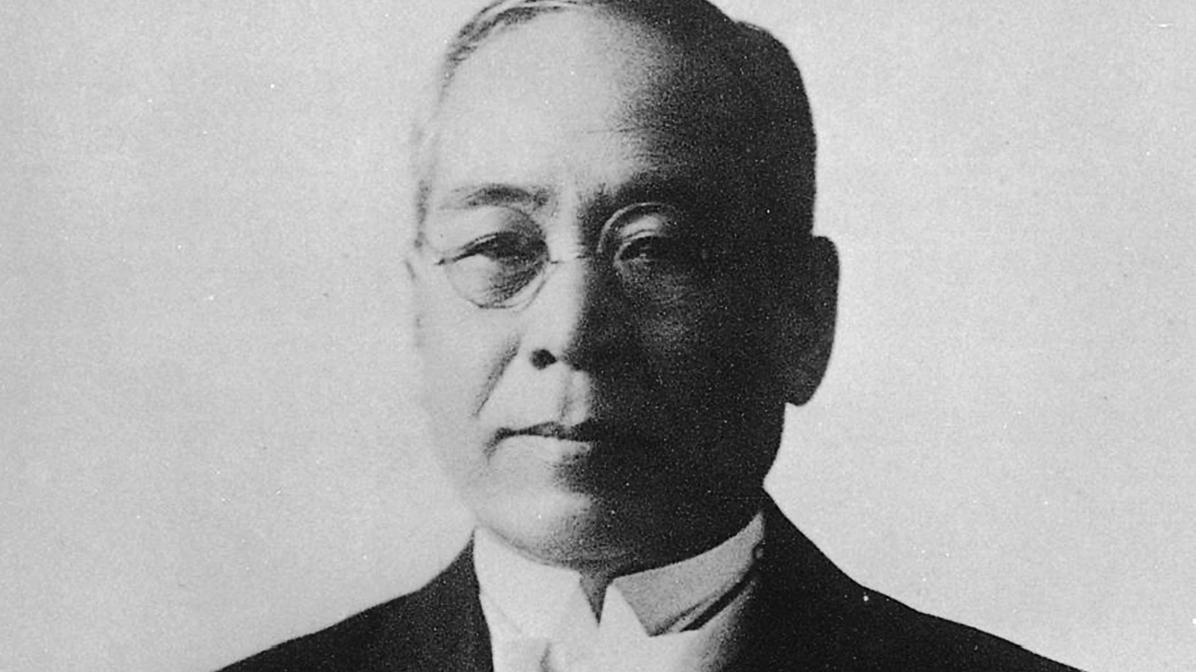
Notes:
The Five Whys method was originally developed by Sakichi Toyoda, the founder of Toyota Industries. This method became widely used in Toyota Motor Corporation and is still used frequently to this day. Taiichi Ohno, the architect of the Toyota Production System, describes the five whys as “the basis of Toyota’s scientific approach.”

Slide 16
Probleem | Põrandal on veeloik
Miks? | Laes olev toru lekib
Miks? | Torus on liiga suur veesurve
Miks? | Ventiil on vigane
Miks? | Ventiile ei ole testitud
Miks? | Pole loodud hooldus graafikut

Slide 17
PROMPT 2
Create a lightweight client management app for freelance designers who avoid sending invoices because they associate money conversations with conflict. The interface should reduce emotional friction and make asking for payment feel calm and professional instead of transactional
Disaini viited

Slide 18
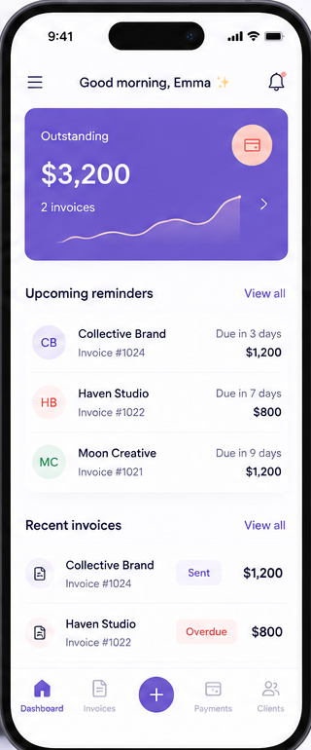

Slide 20


Slide 21
Nõrgad promtid kirjeldavad funktsioone
“Build a dashboard with AI search”

Slide 22
Tugevad promtid kirjeldavad INIMESTE VAJADUSI
“Help overwhelmed operations managers regain trust in messy inventory data”

Slide 24
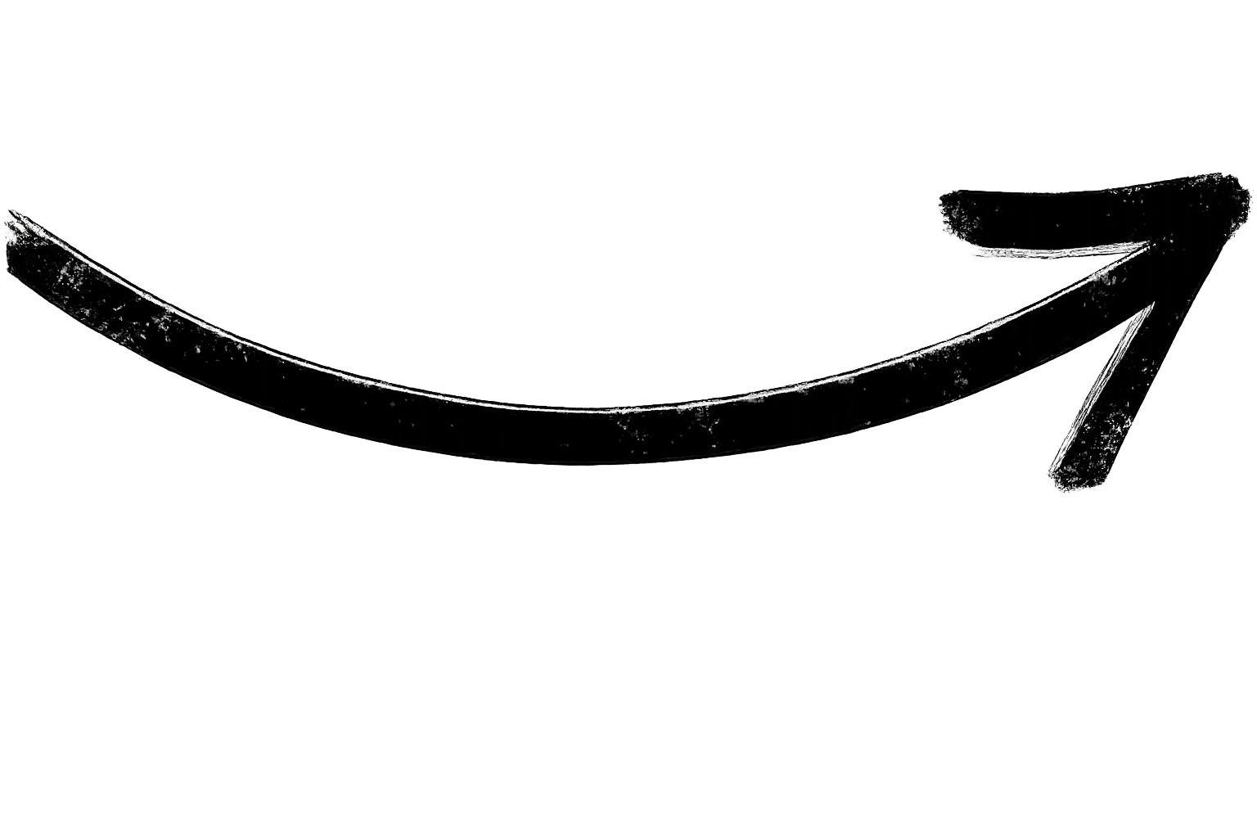
Kolleeg
Kolleeg

Slide 25
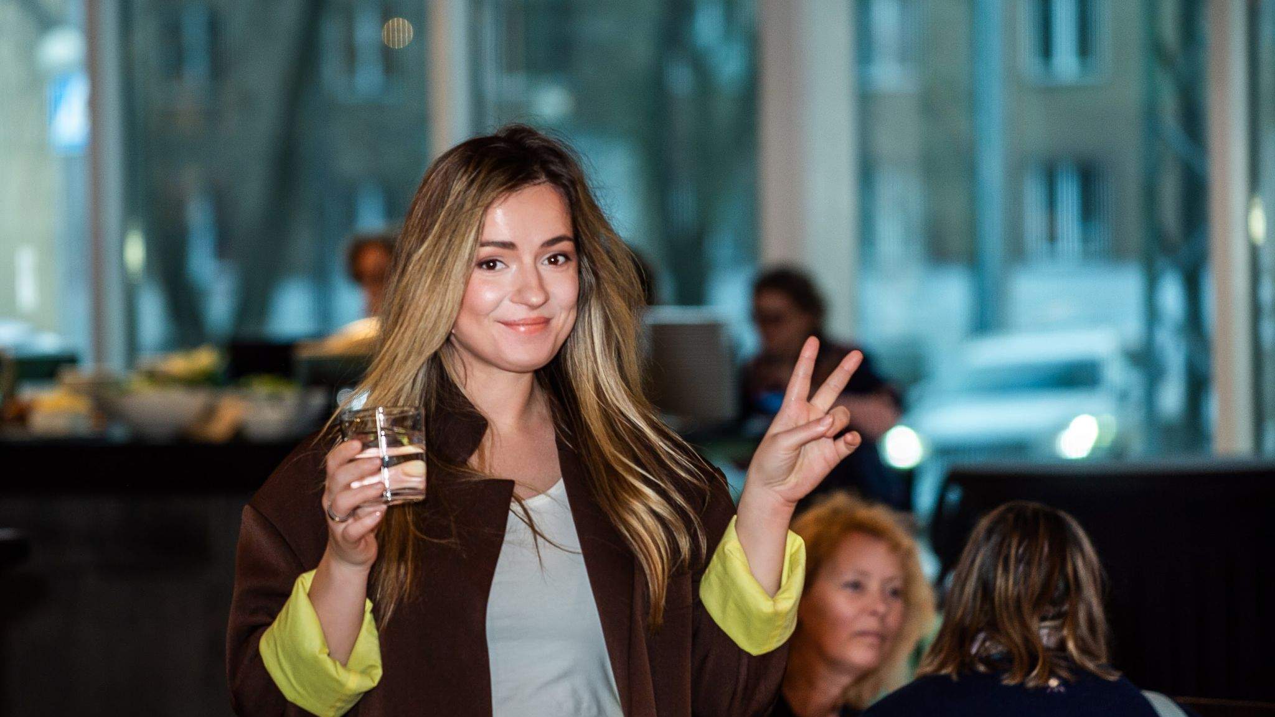

Slide 26
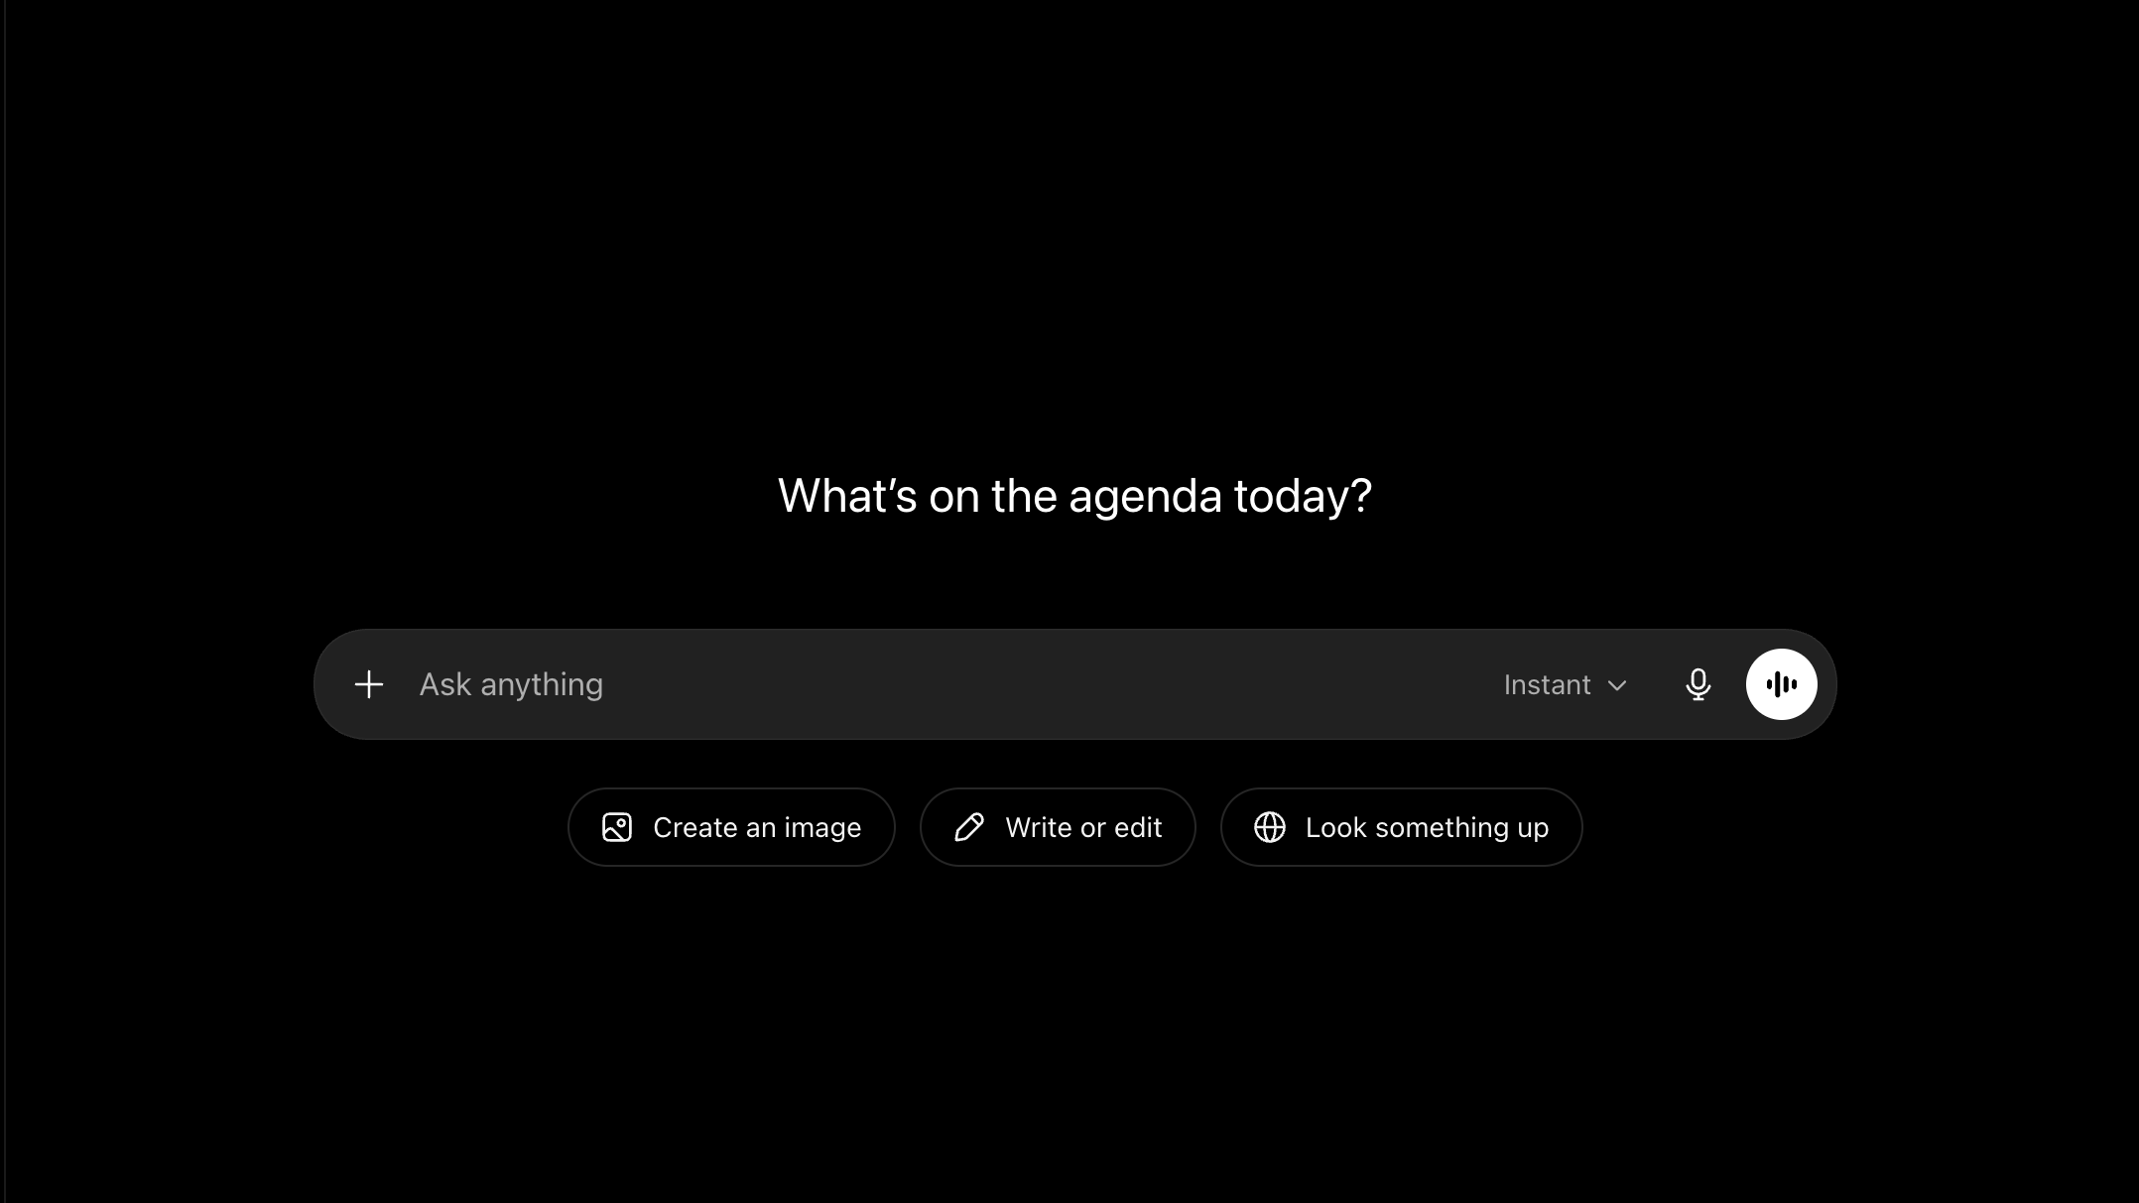

Slide 27

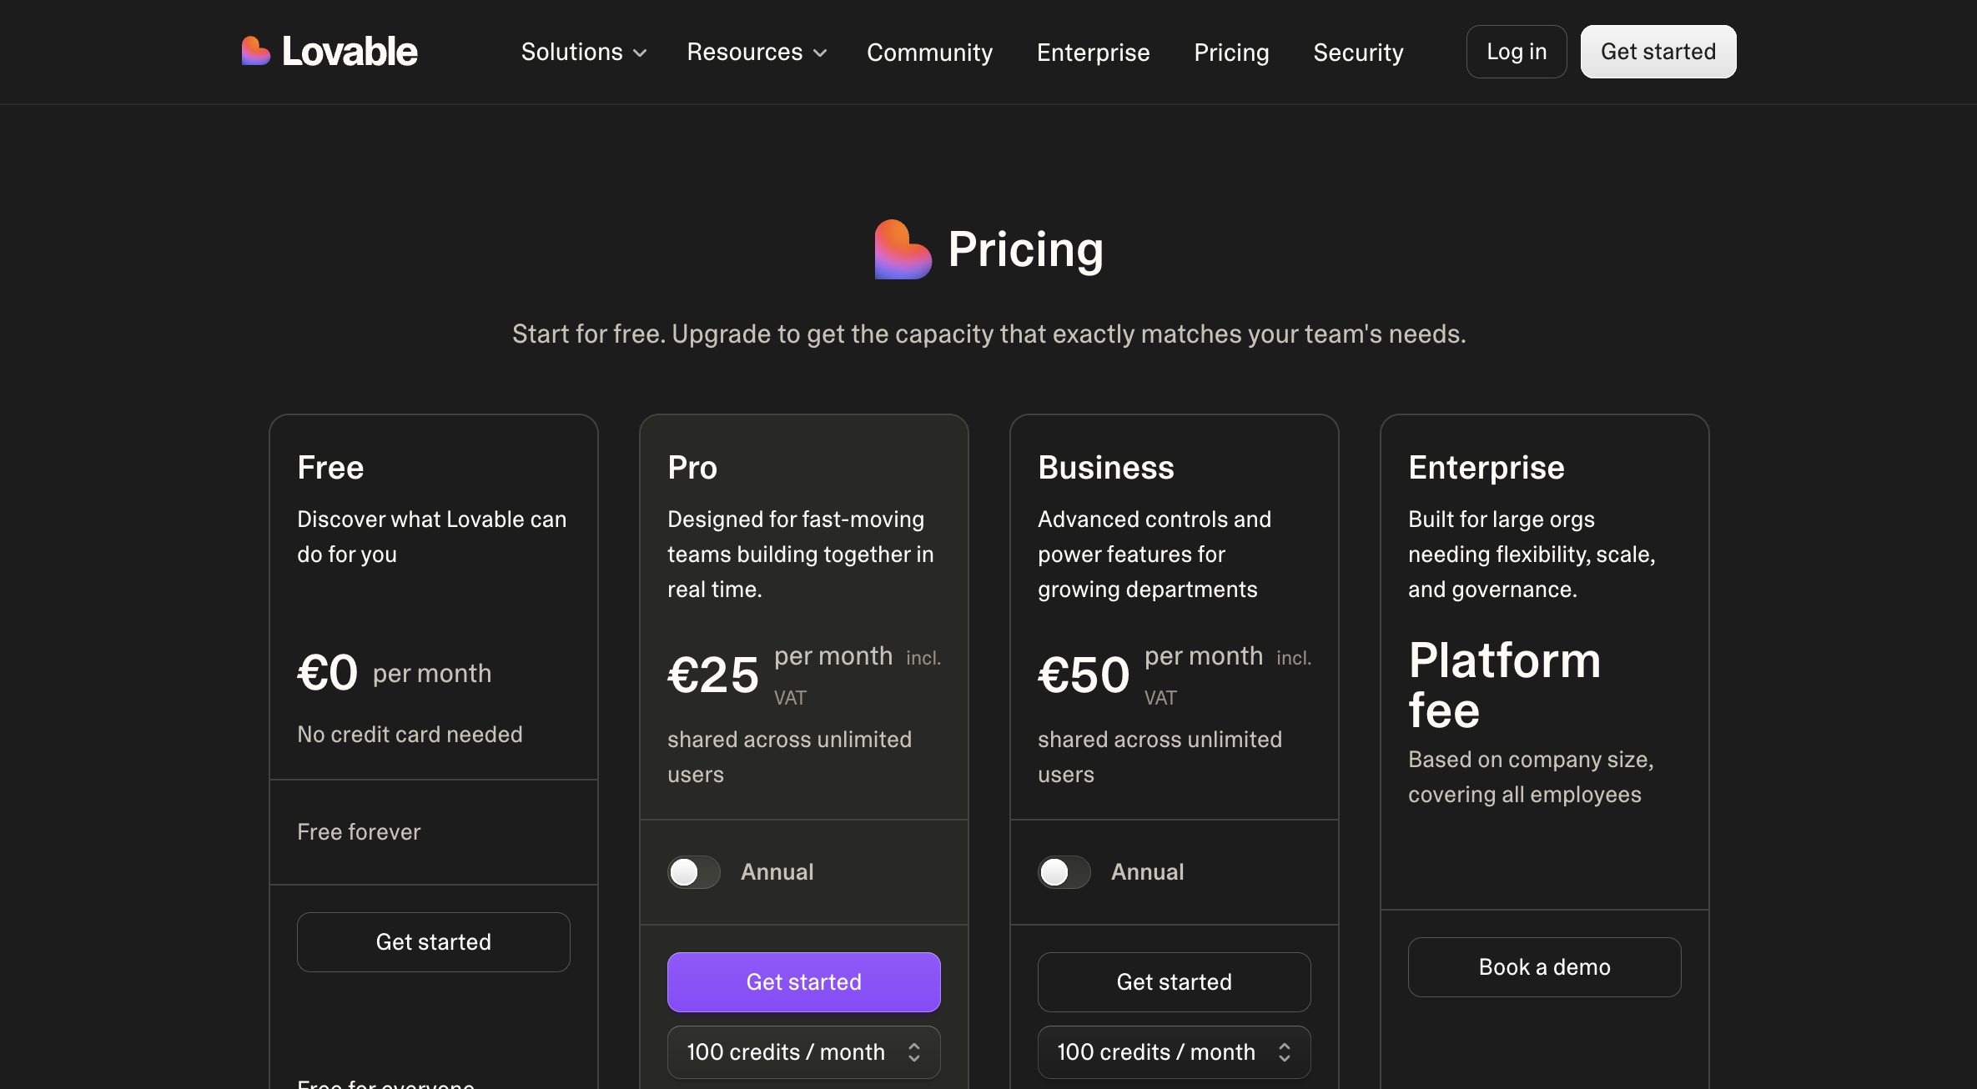
02:28

Slide 28
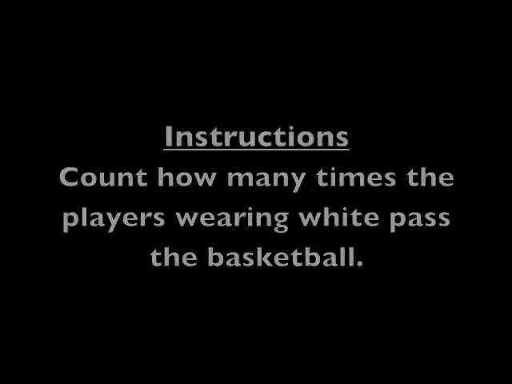

Slide 29
Theme sort

Slide 30


Slide 31
Teema
Teema
Teema

Slide 32
Ära lase AI’l kohe väljundit sünteesida

Slide 33
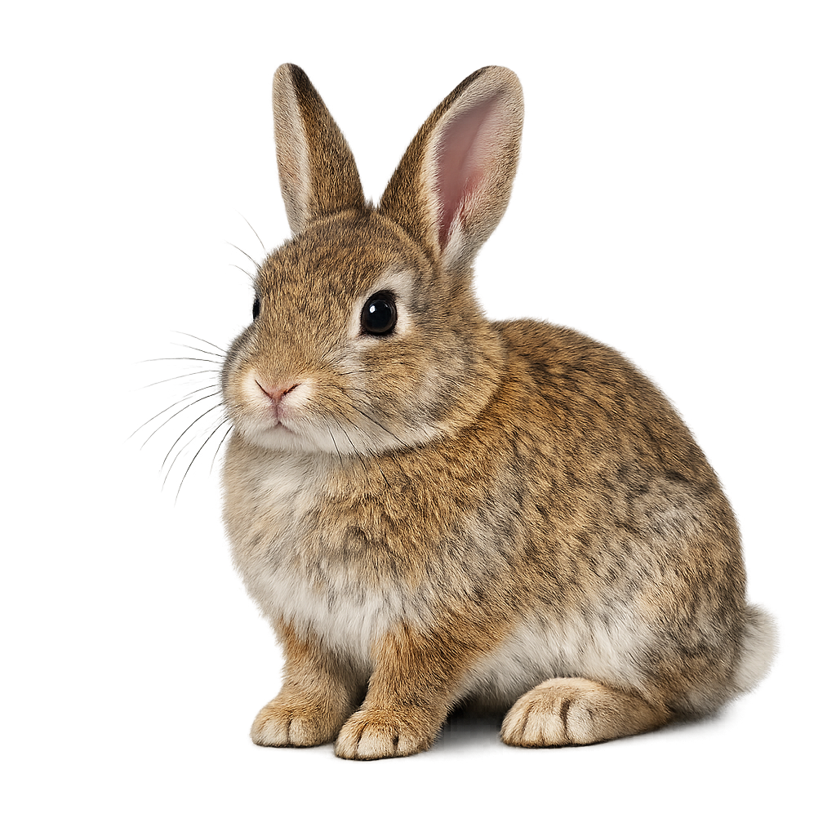

Slide 34
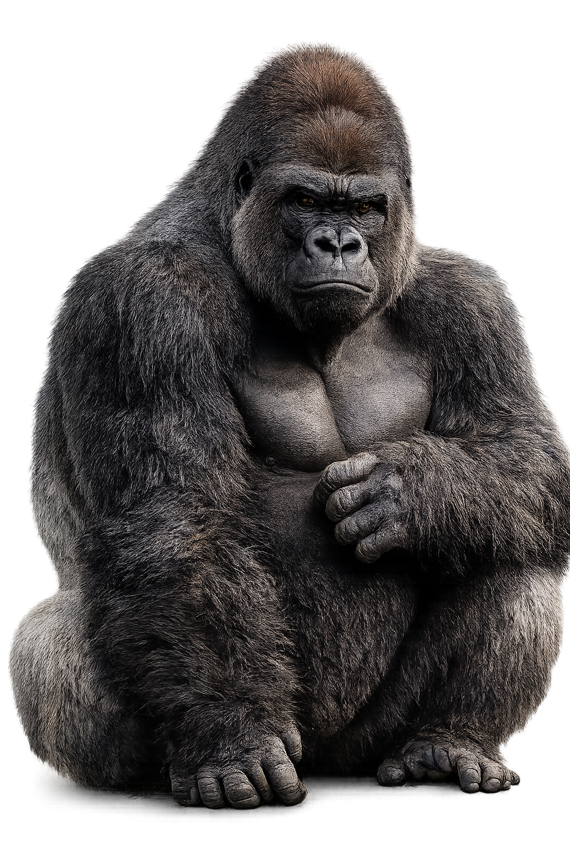

Slide 35
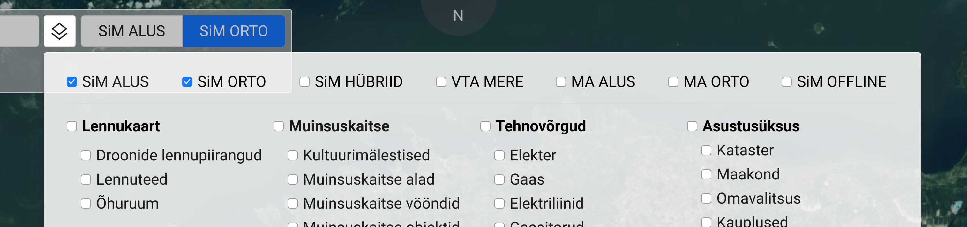

Slide 36
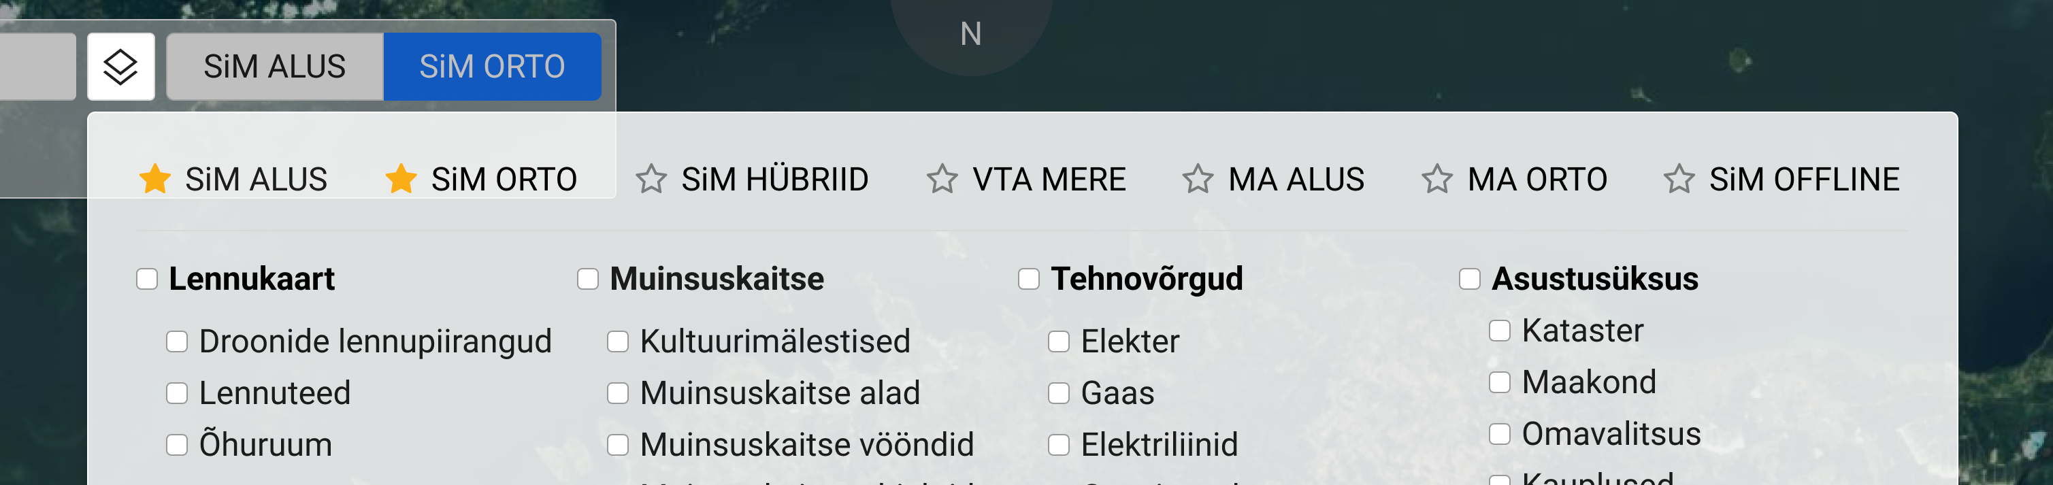

Slide 37


Slide 38
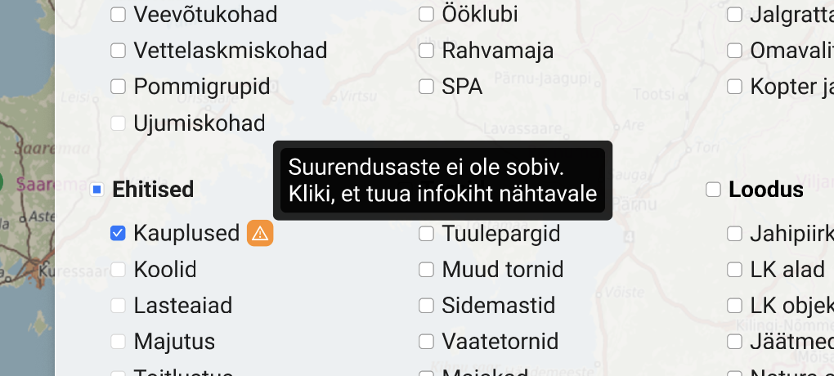

Slide 39
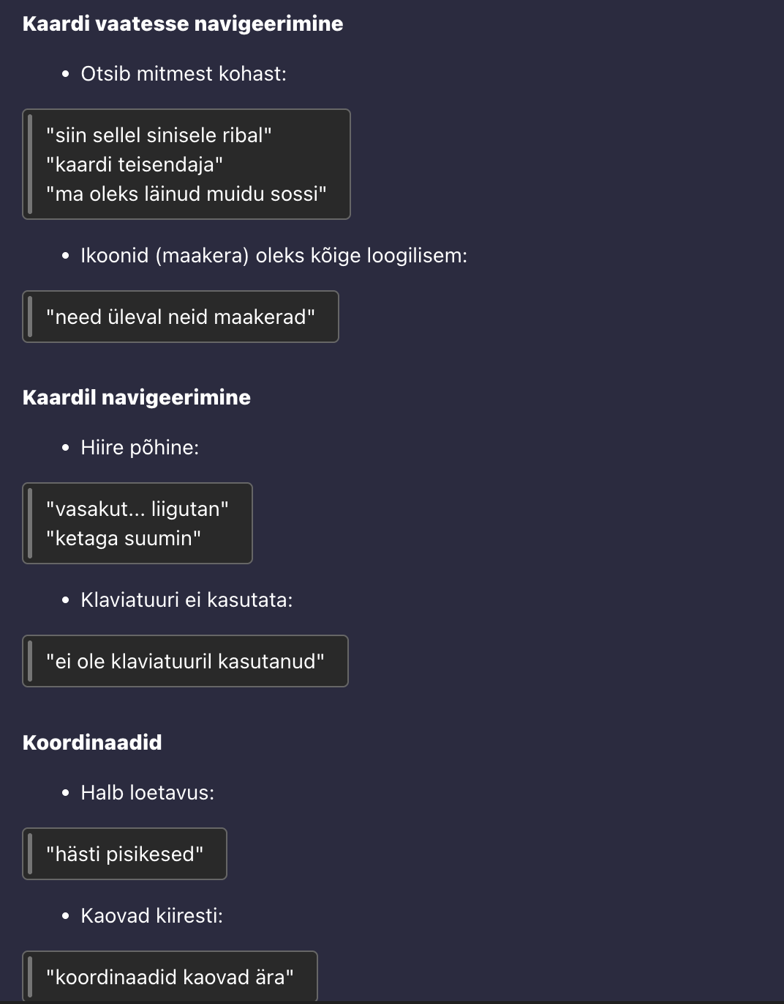

Slide 40
Kõrge mõju
Kiired võidud
Suured projektid
Väike pingutus
Suur pingutus
Täite tööd
Tänamatud ülesanded
Väike mõju

Slide 41
Kõrge mõju
Kiired võidud
Suured projektid
Väike pingutus
Suur pingutus
Täite tööd
Tänamatud ülesanded
Väike mõju

Slide 42
PROMPT
Create a [type of product] for [specific user/pioneer]
who [struggle / behavior / fear / JTBD] because [whys]
The experience should feel [desired emotional tone / design] instead of [negative feeling]

Slide 43
Jakob’i seadus
Notes:
Users spend most of their time in other apps.

Slide 44
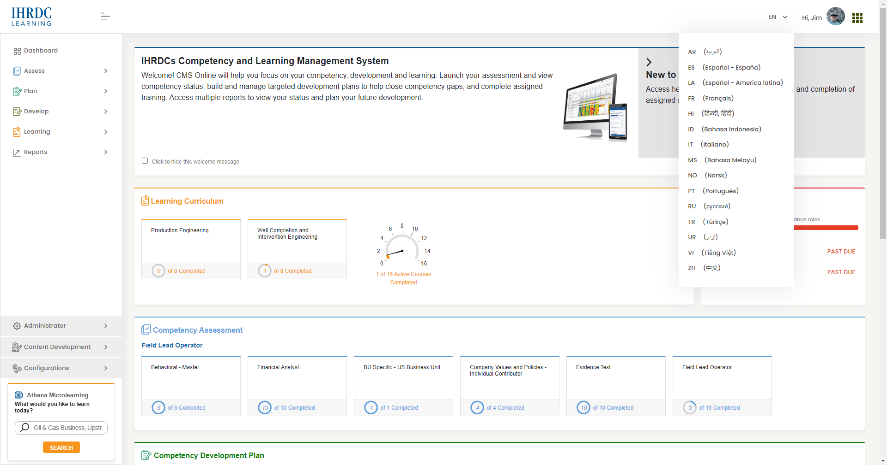

Slide 45
“Follow Jakob’s Law using familiar navigation and interaction patterns”

Slide 46
Hick’i seadus
Notes:
Too many choices create paralysis.

Slide 47
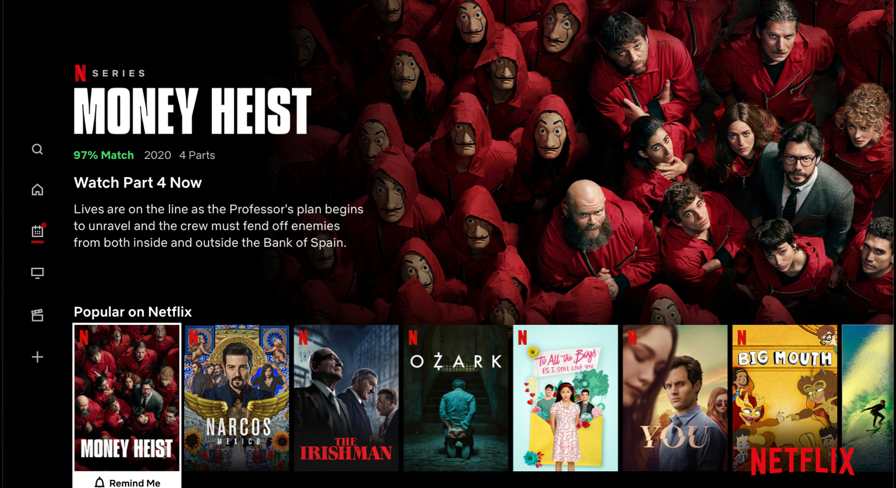

Slide 48
“Apply Hick’s Law by limiting decisions per screen”

Slide 49
Tesler’i seadus
Notes:
Every system has unavoidable complexity.
Either:
user handles it,
or product handles it.

Slide 50
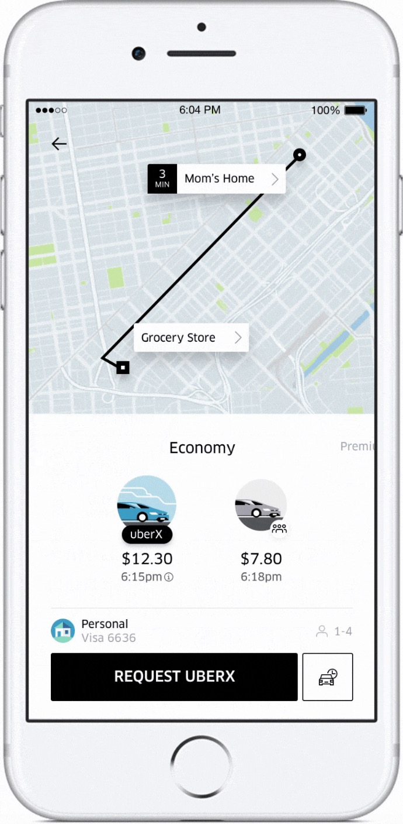

Slide 51
“Apply Tesler’s Law by automating repetitive setup tasks” “Hide unnecessary accounting complexity”
“Make progress feel effortless”

Slide 52
Fitts’i seadus
Notes:
Important actions should be easy to reach.

Slide 53
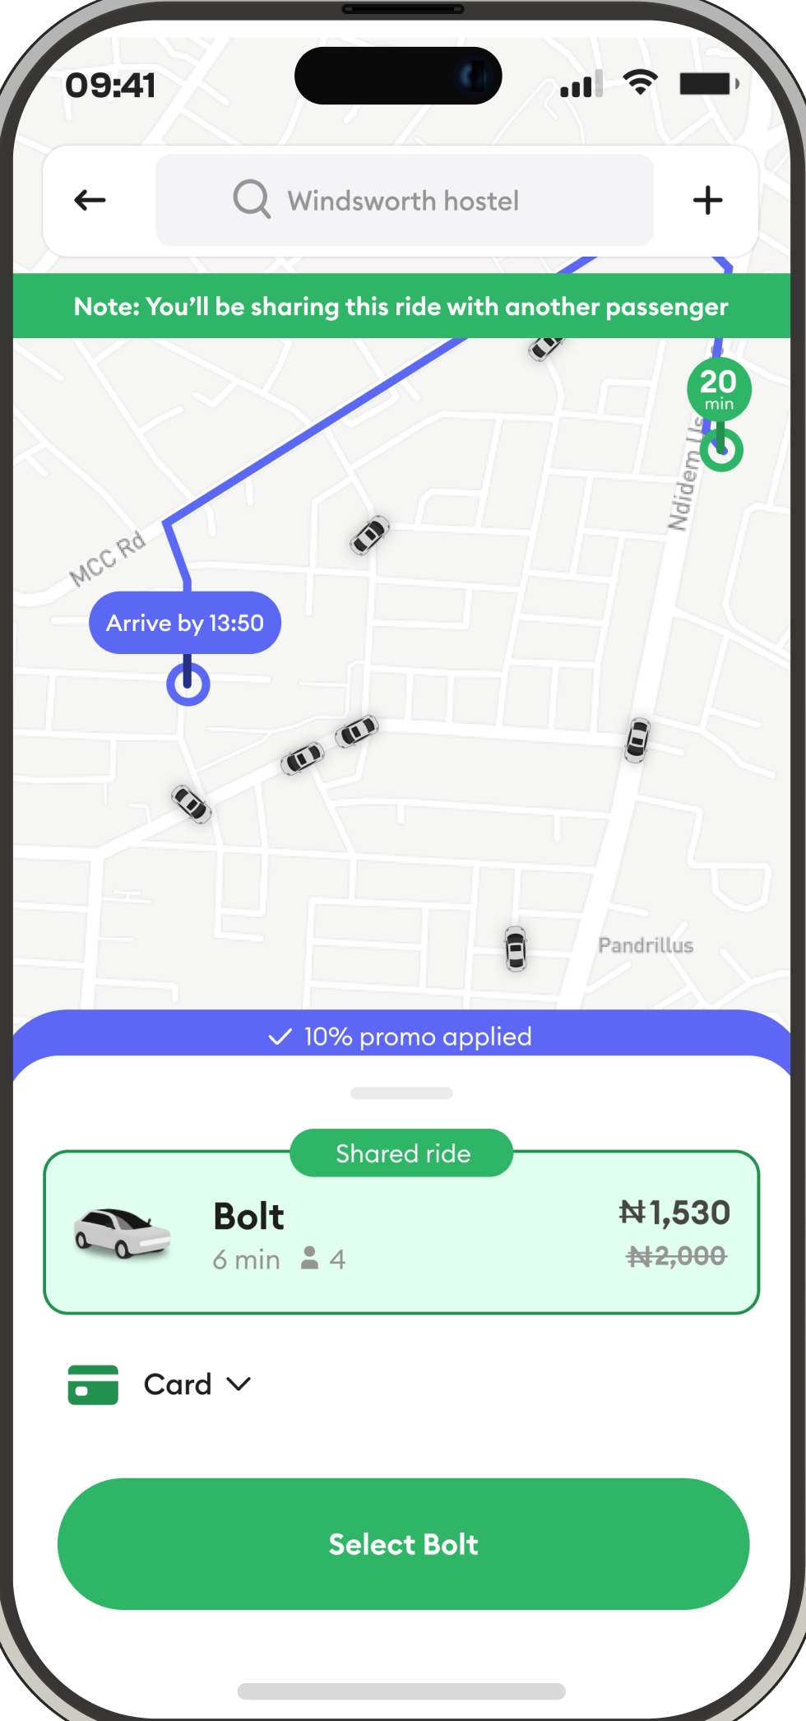

Slide 54
“Apply Fitts’s Law with large high-confidence tap targets” “Reduce accidental input errors”

Slide 55
NB 1
Notes:
Every system has unavoidable complexity.
Either:
user handles it,
or product handles it.

Slide 56
WCAG AA
Notes:
Every system has unavoidable complexity.
Either:
user handles it,
or product handles it.

Slide 57
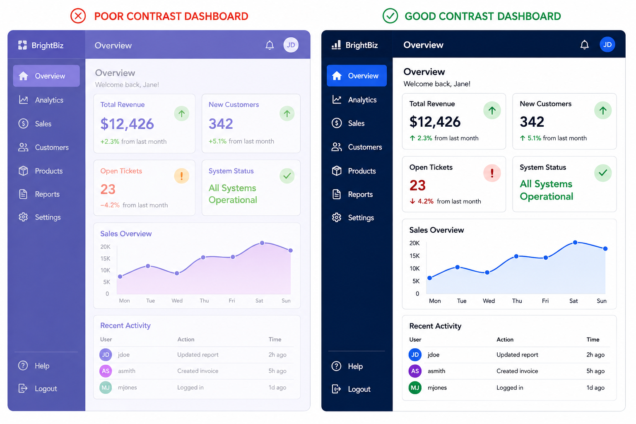
Notes:
Every system has unavoidable complexity.
Either:
user handles it,
or product handles it.

Slide 58
“Design and implement this prototype to meet WCAG 2.2 AA accessibility standards by default.”

Slide 59
NB 2
Notes:
Every system has unavoidable complexity.
Either:
user handles it,
or product handles it.

Slide 60
